Slide 1

Employee Data Analysis using Excel
STUDENT NAME: Santhoshini.R
REGISTER NO: 312209233
DEPARTMENT: B.com Bank Management
COLLEGE: Anna Adarsh College For Women
1
Notes:
1

Slide 2

PROJECT TITLE
Employee Performance Analysis using Excel
2

Slide 3



AGENDA
Problem Statement
Project Overview
End Users
Our Solution and Proposition
Dataset Description
Modelling Approach
Results and Discussion
Conclusion
3/21/2024 Annual Review
3

Slide 4

PROBLEM STATEMENT
1. "Women are underrepresented in leadership positions, holding only X% of managerial roles despite making up Y% of the workforce."
2. "Male employees are more likely to receive promotions and opportunities for advancement than female employees with similar qualifications and experience."
4

Slide 5

PROJECT OVERVIEW
*Objective:* To promote gender equality and inclusivity in the workplace, addressing disparities and biases that impact employees' experiences, opportunities, and well-being.
*Scope:- Identify and address pay disparities
- Increase representation of underrepresented genders in leadership and key roles
- Develop inclusive hiring practices
- Provide training on unconscious bias, microaggressions, and allyship
- Enhance policies and support for work-life balance, caregiving, and parental leave
- Foster a culture of respect, empathy, and inclusivity
.
5

Slide 6

WHO ARE THE END USERS?
1. HR Personnel: HR teams use employee data for recruitment, onboarding, benefits administration, performance management, and compliance.
2. Managers and Supervisors: Managers use employee data to track performance, manage workflows, and make informed decisions about promotions and development opportunities.
6

Slide 7
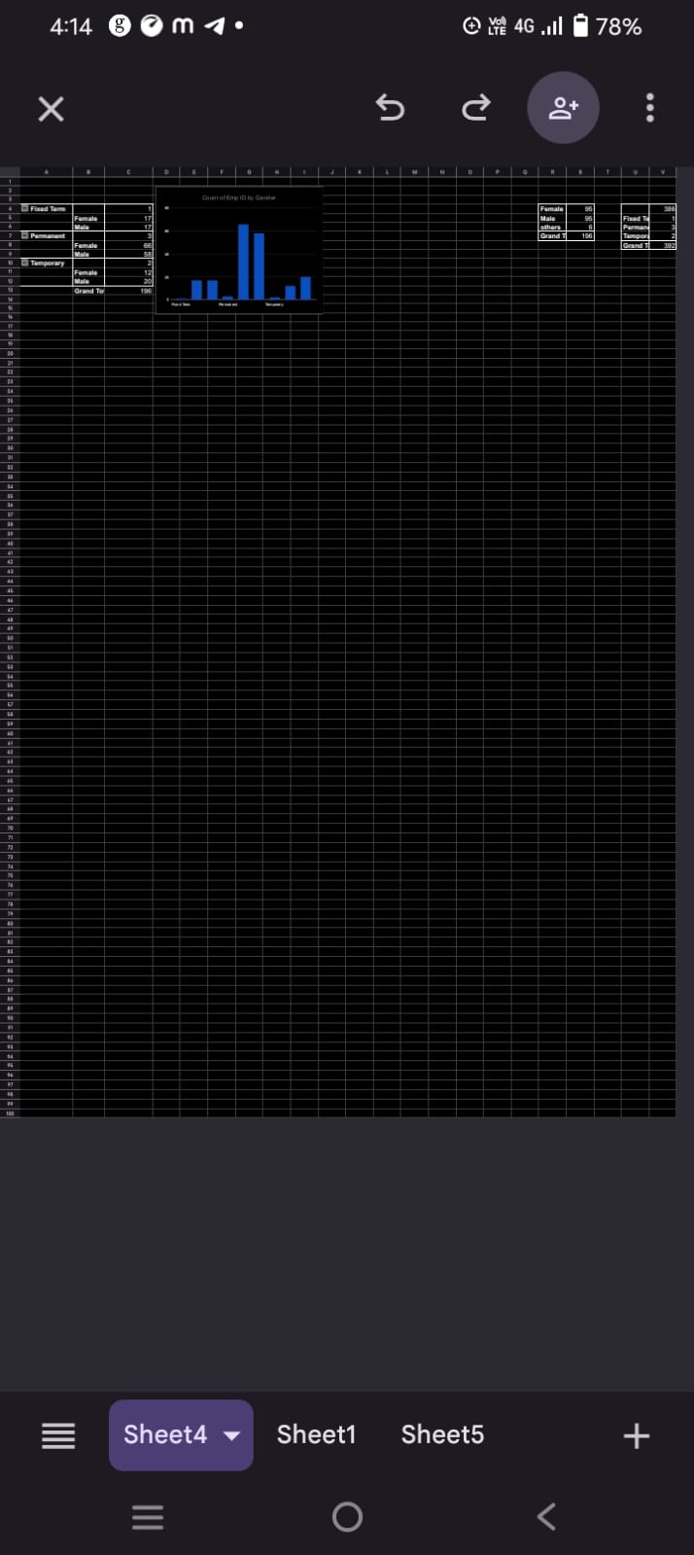
RESULTS
11

Slide 8
conclusion
These conclusions highlight areas for improvement and provide a foundation for developing targeted strategies to promote gender equality and inclusivity in the workplace.

